Slide 1
OPTIMIZING RESOURCE ALLOCATION FOR 5G NETWORKS USING ADVANCED MACHINE LEARNING TECHNIQUES
Team Members:
21i320 Karthik R
21i343 Prithiv Vijai U G
21i344 Pukalvanan L
21i366 Vinu V
Project Guide
Dr. Anitha Kumari K
Associate Professor
Department of Information Technology
PSG College of Technology
Coimbatore.

Slide 2
Agenda: -
Problem Statement
Objective
Scope of the project
Literature Survey
Proposed Methodology
Work done so far
Requirements
Timeline
References

Slide 3
Problem Statement:
The increasing demand for high-quality and real-time applications in 5G networks necessitates efficient resource allocation mechanisms in Edge Computing.
The challenge lies in dynamically allocating resources such as bandwidth and signal strength to different applications with varying latency requirements.
Achieving realistic resource allocation efficiency by analyzing these parameters is crucial for understanding and optimizing the efficiency of each user, ultimately enhancing the overall performance.

Slide 4
Objective
Real-Time 5G Data: Acquire or create efficient real-time 5G user data, including signal strength, application type, latency, and bandwidth metrics to ensure accurate and relevant inputs for analysis.
Analyze Correlation Factors: Investigate how all the factors correlate with resource allocation to identify key influences on network performance.
Evaluate Predictive Models: Explore and assess various predictive models to determine their effectiveness in forecasting resource allocation based on the collected dataset.
Optimize Resource Allocation: Further develop a model-driven framework to enhance resource allocation strategies based on predicted efficiency.

Slide 5
Scope of the Project :
Data Collection and Generation: Focus on gathering or generating comprehensive real-time 5G user data, including metrics on signal strength, application types, latency, and bandwidth usage, to provide a solid foundation for analysis.
Parameter Analysis: Examine how different parameters such application type , latency, signal strength , bandwidth impact resource allocation, with a goal to uncover patterns and correlations that influence performance.
Model Development and Testing: Implement and test a variety of predictive models to assess their ability to accurately forecast resource needs, ensuring that the models are suited to handle real-time data effectively (single objective).

Slide 6
Literature Survey: -
S.No | Title and Authors of the paper | Publication Year and Conference | Inferences | Drawbacks
1. | 5G Traffic Prediction Based on Deep Learning. Zihang Gao. | Computational and Intelligence Neuroscience. (2022) | This paper introduces an SLSTM model for predicting 5G network traffic, which adapts its complexity and stabilizes output sequences, showing significant improvements over traditional methods. | The proposed SLSTM model could benefit from incorporating a broader spectrum of factors influencing 5G traffic to further enhance its predictive accuracy and applicability in real-world settings.
2. | Deep Learning Models Applied to Prediction of 5G Technology Adoption. Ikhlas Fuad Zamzami | Applied Sciences. (2023) | This paper employs DR, LSTM, and CNN deep learning models to predict 5G adoption factors using channel metrics, context metrics, cell metrics, and throughput data. It underscores the effectiveness of the proposed DR and CNN models, despite issues with LSTM's data quality. | ,The paper acknowledges limitations in dataset representation and the proposed deep learning algorithm's contextual understanding, suggesting potential for improvement in future research.

Slide 7
Cont’d: -
3. | Research on throughput prediction of 5G network based on LSTM. L. Li and T. Ye | Intelligent and Converged Networks. June 2022 | This paper proposes an LSTM-based wireless network traffic prediction model, showing promising prediction accuracy and training speed through simulations with different 5G service scheduling algorithms. | Further optimizations are needed for parameter settings and operational efficiency to enhance future performance and algorithm design.
4. | 5G Multi-Access Edge Computing: A Survey on Security, Dependability, and Performance. G. Nencioni, R. G. Garroppo and R. F. Olimid | IEEE Access. (2023) | This paper surveys security, dependability, and performance aspects of 5G Multi-access Edge Computing (MEC), providing insights into challenges and advancements through taxonomy and state-of-the-art findings. | The proposed joint addressing of security, dependability, and performance in 5G MEC requires further research to enhance robustness for evolving network demands.

Slide 8
Cont’d: -
5. | Edge Computing Resource Allocation Method for Mining 5G Communication System. L. Zhang, W. Yang, B. Hao, Z. Yang and Q. Zhao | IEEE Access. (2023) | This paper proposes an edge computing-based solution using 5G wireless base stations to enhance underground 5G communication in coal mines, significantly reducing task execution delay and improving transmission rates. | Further validation in diverse operational environments and scalability testing are needed to ensure robustness and effectiveness in real-world mining scenarios.
6. | Implementation and Evaluation of 5G MEC-Enabled Smart Factory. Rekoputra, N. M, Tseng, C.-W,Wang, J.-T, Liang, S.-H, Cheng, R.-G, Li, Y.-F, Yang, W.-H. | Electronics 12. (2023) | This paper demonstrates that integrating MEC with 5G networks enhances performance metrics significantly compared to non-MEC setups, WiFi 6, and Ethernet, crucial for Industry 4.0 applications. | The proposed MEC implementation requires authentication from MNOs for industrial networks, potentially restricting accessibility and deployment flexibility.

Slide 9
Cont’d: -
7. | Integrating Multi-Access Edge Computing (MEC) into Open 5G Core Xavier, Ruben, Rogério S. Silva, Maria Ribeiro, Waldir Moreira, Leandro Freitas, and Antonio Oliveira- | Telecom 5 (2024) | This paper proposes a new MTS API extension to integrate MEC with the 5G core, validating its feasibility in high-density scenarios like e-Health and Smart Farms, meeting 5G MEC applications. | The implementation and validation are performed in a virtualized environment, which may not fully replicate real-world conditions.
8. | Research on the 5G MEC Co-construction and Sharing | 2024 4th International Conference on Neural Networks, Information and Communication Engineering (NNICE), Guangzhou, China, (2024) | This paper explores 5G operator collaboration through co-construction and sharing to enhance network efficiency and reduce costs, focusing on NSA to SA network evolution and addressing security and performance challenges. | This paper doesn't provide real-world data on cost savings

Slide 10
Drawbacks of existing system: -
Absence of Efficiency Metrics: Current systems lack metrics to gauge resource allocation efficiency, hindering performance assessment and improvement.
Unclear Influence of Parameters: Limited understanding of how parameters like signal strength and latency affect resource allocation impedes accurate analysis and adjustment.
Limited Optimization Capabilities: Inadequate measurement tools prevent effective optimization, leading to inefficient resource use and diminished network performance.
Resulting Issues: Inefficient resource allocation causes increased latency, poor application performance, user dissatisfaction, and network congestion, resulting in higher costs and reduced overall system efficiency.

Slide 11
Proposed methodology:

Slide 12
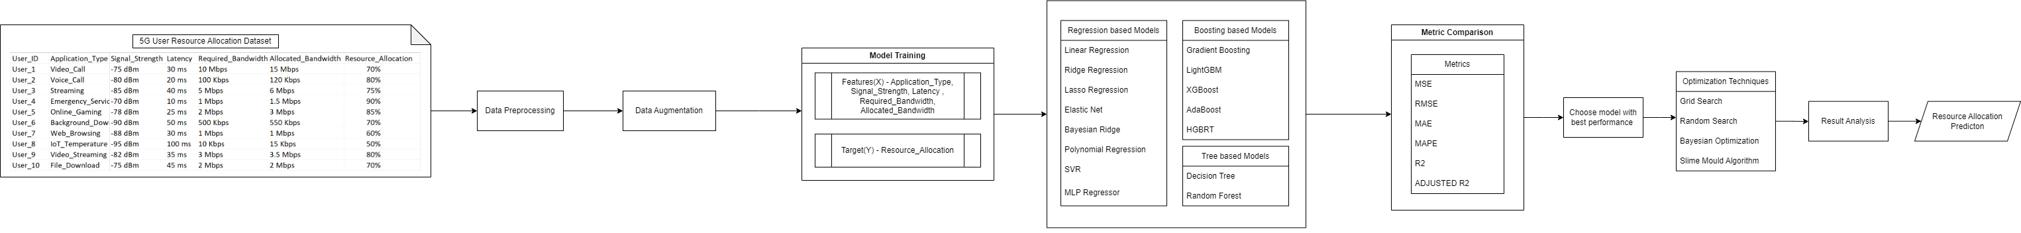
Proposed methodology – Block diagram
Continuation in next page

Slide 13
Proposed methodology – Block diagram
Continuation in next page

Slide 14
Proposed methodology:

Slide 15
Preprocessing
Removed Timestamp: Eliminated the Timestamp attribute.
Encoded Application Type: Applied numeric encoding to application_type.
Standardized Bandwidth: Unified units for Required_bandwidth and Allocated_bandwidth.
Stripped Symbols: Removed ‘%’, ‘dBm’, and ‘ms’ from attributes.
Refined User ID: Ensured User_Id contains only the ID
Original Dataset
Timestamp | User_ID | Application_Type | Signal_Strength | Latency | Required_Bandwidth | Allocated_Bandwidth | Resource_Allocation
09-03-2023 10:00 | User_1 | Video_Call | -75 dBm | 30 ms | 10 Mbps | 15 Mbps | 70%
09-03-2023 10:00 | User_2 | Voice_Call | -80 dBm | 20 ms | 100 Kbps | 120 Kbps | 80%
09-03-2023 10:00 | User_3 | Streaming | -85 dBm | 40 ms | 5 Mbps | 6 Mbps | 75%
09-03-2023 10:00 | User_4 | Emergency_Service | -70 dBm | 10 ms | 1 Mbps | 1.5 Mbps | 90%
09-03-2023 10:00 | User_5 | Online_Gaming | -78 dBm | 25 ms | 2 Mbps | 3 Mbps | 85%
09-03-2023 10:00 | User_6 | Background_Download | -90 dBm | 50 ms | 500 Kbps | 550 Kbps | 70%
09-03-2023 10:00 | User_7 | Web_Browsing | -88 dBm | 30 ms | 1 Mbps | 1 Mbps | 60%
09-03-2023 10:00 | User_8 | IoT_Temperature | -95 dBm | 100 ms | 10 Kbps | 15 Kbps | 50%
09-03-2023 10:00 | User_9 | Video_Streaming | -82 dBm | 35 ms | 3 Mbps | 3.5 Mbps | 80%
Preprocessed Dataset
User_ID | Application_Type | Signal_Strength | Latency | Required_Bandwidth | Allocated_Bandwidth | Resource_Allocation
1 | 6 | -75 | 30 | 10000 | 15000 | 70
2 | 9 | -80 | 20 | 100 | 120 | 80
3 | 5 | -85 | 40 | 5000 | 6000 | 75
4 | 1 | -70 | 10 | 1000 | 1500 | 90
5 | 4 | -78 | 25 | 2000 | 3000 | 85
6 | 0 | -90 | 50 | 500 | 550 | 70
7 | 10 | -88 | 30 | 1000 | 1000 | 60
8 | 3 | -95 | 100 | 10 | 15 | 50
9 | 7 | -82 | 35 | 3000 | 3500 | 80

Slide 16
Data Augmentation
Augmented Dataset: Expanded the dataset from 400 to 16,000 records.
Equal Distribution: Ensured balanced distribution across each application_type.
Comparison of Techniques: Evaluated correlation differences for various augmentation methods, including:
Random Over Sampling
Gaussian Noise Augmentation
GAN
MLP – ANN
SMOGN
Consistency of Features: Maintained consistent average values for each feature.
Correlation Results: Observed similar correlation outcomes across all augmentation methods and used the best method with higher correlation similarity.

Slide 17
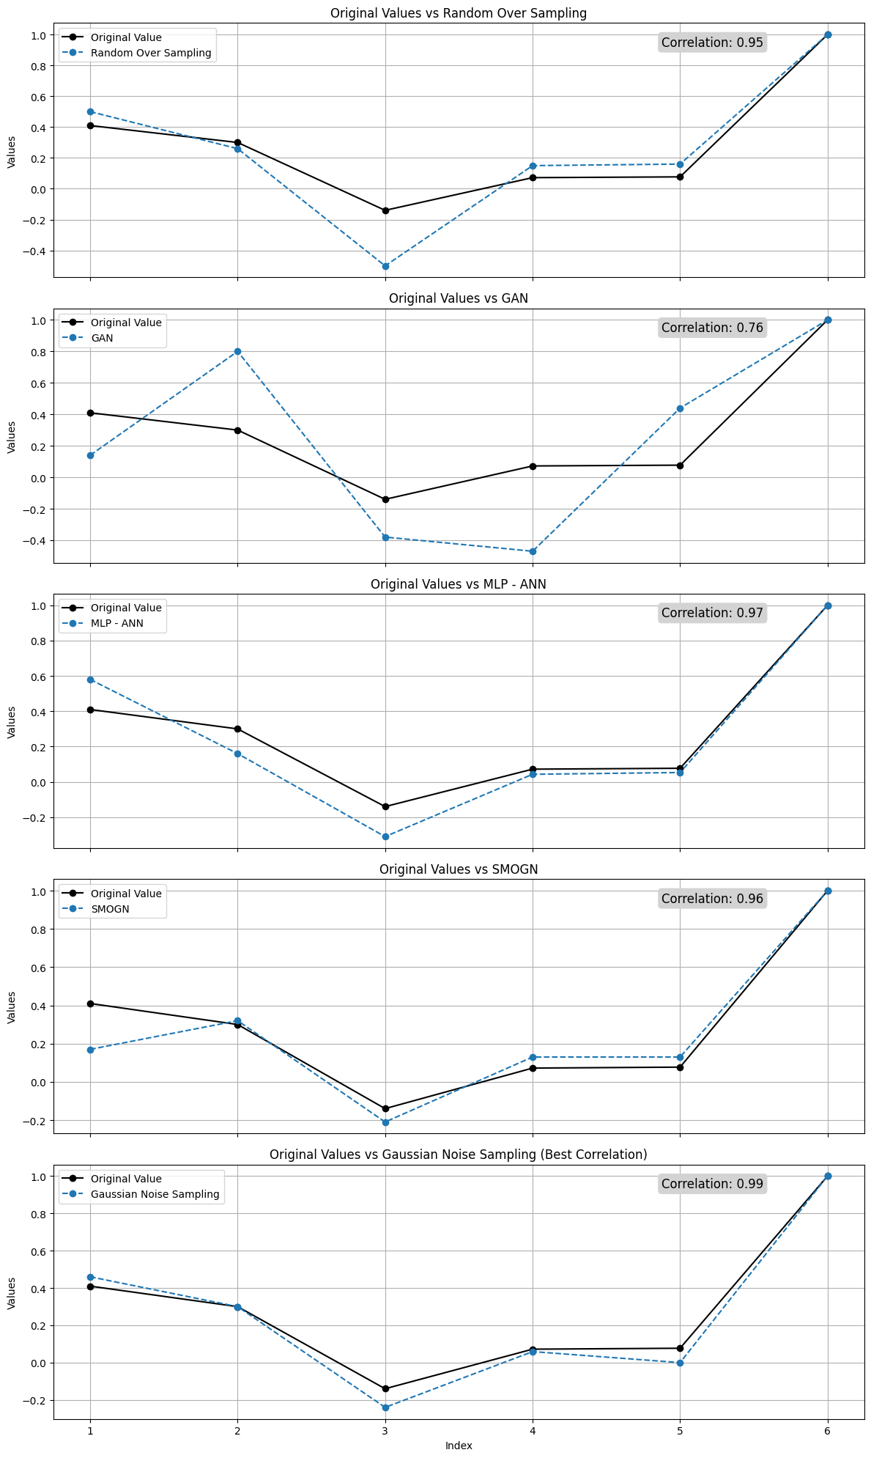
Data Augmentation – Correlation similarity with original dataset
Random Over Sampling
GAN

Slide 18
Data Augmentation – Correlation similarity with original dataset
MLP-ANN
SMOGN

Slide 19
Data Augmentation – Correlation similarity with original dataset
Gaussian Noise Sampling
Augmented dataset with Gaussian Noise Sampling method gives the highest correlation similarity score – 0.99

Slide 20
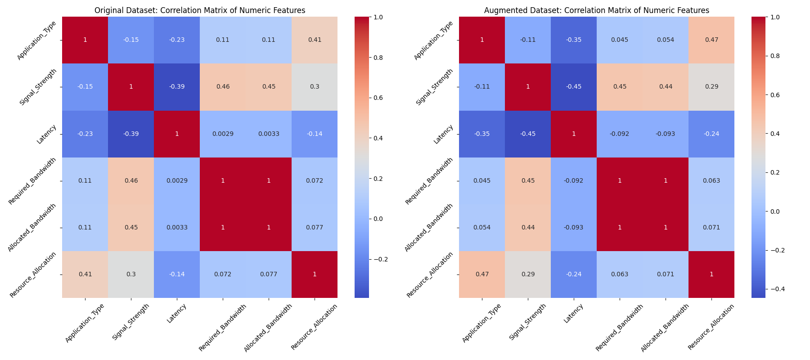
Data Augmentation - Correlation similarity with original dataset
Correlation Matrix of Original dataset vs Augmented dataset (Gaussian Noise Sampling)

Slide 21
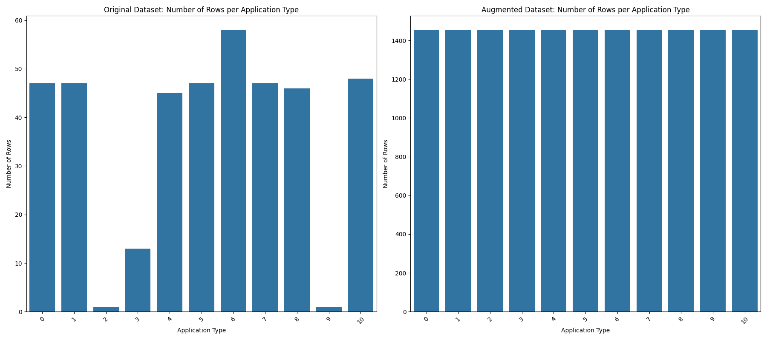
Data Augmentaion – Comparitive Analysis
Number of data in Original dataset vs Augmented dataset (Gaussian Noise Sampling)
for Each Application Type

Slide 22
Model Selection : Regression Based Models
Linear Regression: A basic linear approach to modeling the relationship between a dependent variable and one or more independent variables.
Ridge Regression: Adds regularization to Linear Regression to prevent overfitting by penalizing large coefficients.
Lasso Regression: Similar to Ridge, but with L1 regularization, which can set some coefficients to zero, effectively selecting features.
Elastic Net: Combines L1 and L2 regularization from Lasso and Ridge, balancing their benefits.
Bayesian Ridge: A probabilistic model that incorporates prior distributions into the regression analysis.

Slide 23
Model Selection : Regression Based Models
Polynomial Regression: Extends Linear Regression by fitting a polynomial equation, capturing non-linear relationships.
SVR (Support Vector Regression): Uses support vector machines to perform regression, focusing on the margins of the best fit line.
MLP Regressor: A neural network-based regressor that can capture complex, non-linear relationships.

Slide 24
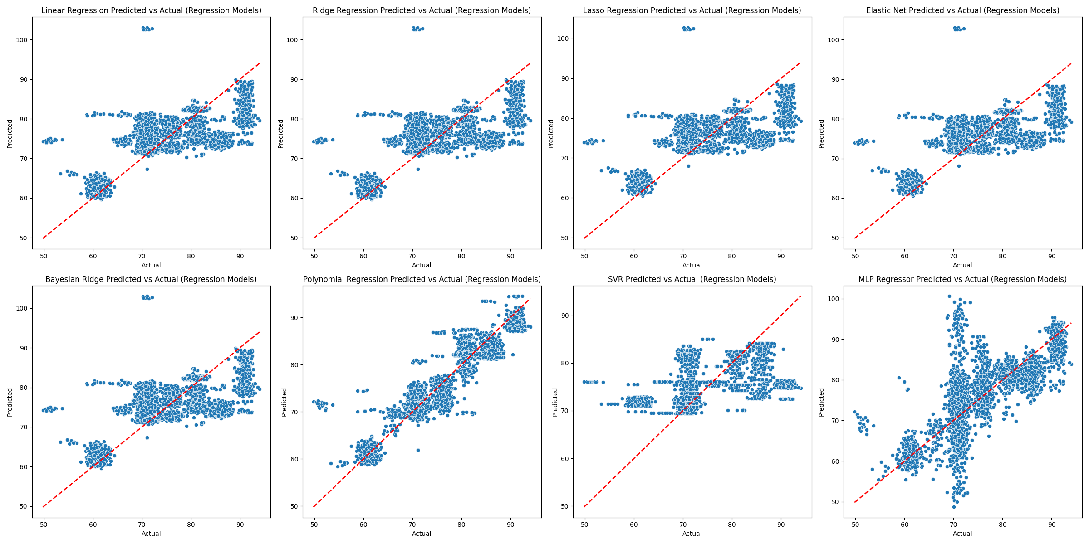
Regression models - Actual vs Predicted
Scatter plot graph of Eight Regression Model.

Slide 25
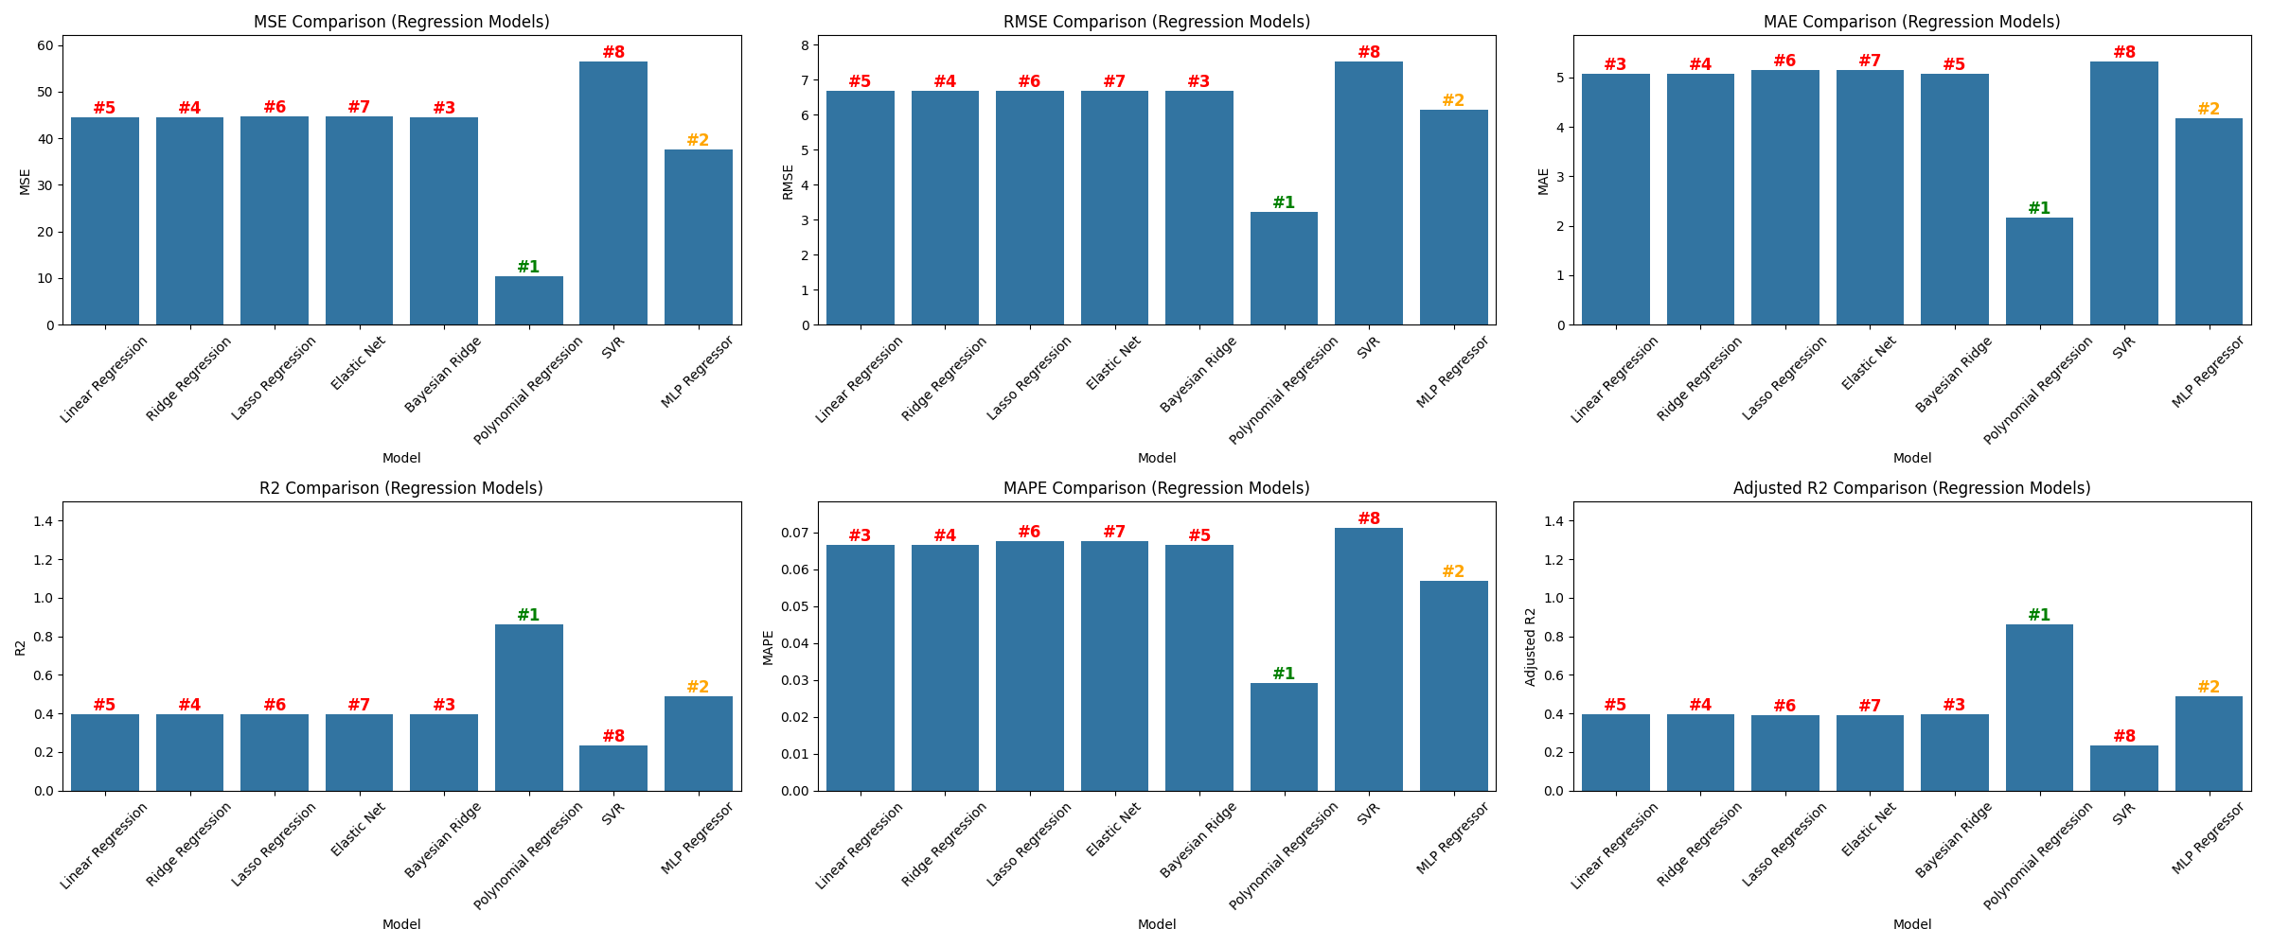
Regression models – Metric comparison
Metric Comparison of Eight Regression Model.

Slide 26
Model Selection : Tree Based Models
Decision Tree Regressor: Splits the data into subsets based on the feature that results in the most homogenous subsets.
Random Forest Regressor: An ensemble method that uses multiple decision trees to improve predictive accuracy and control overfitting.

Slide 27
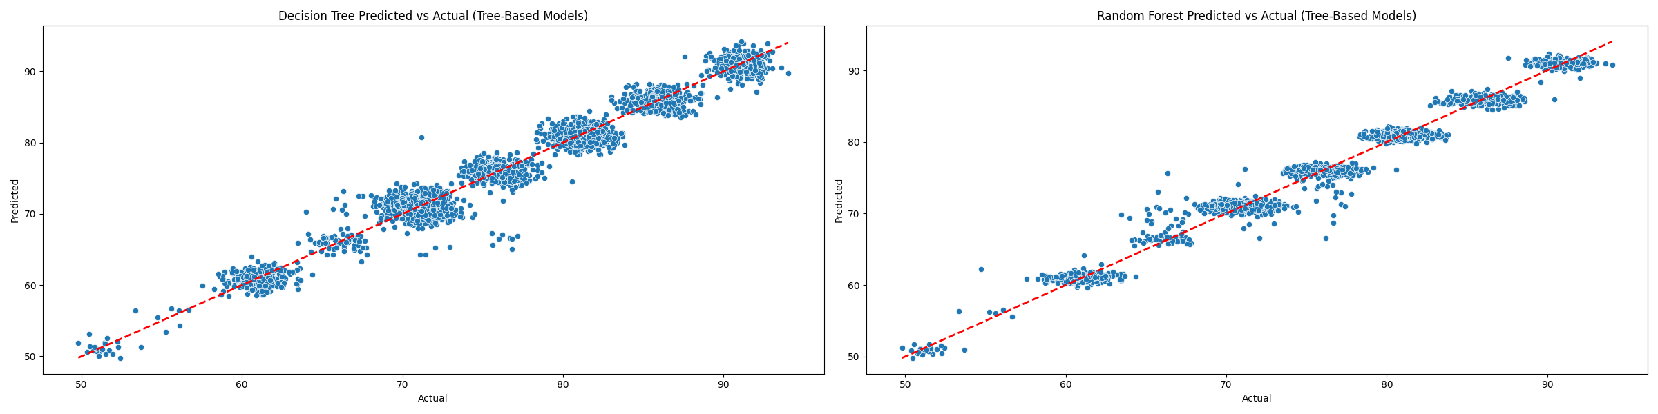
Tree based models– Actual vs Predicted
Scatter Plot Graph of Tree Based Models.

Slide 28
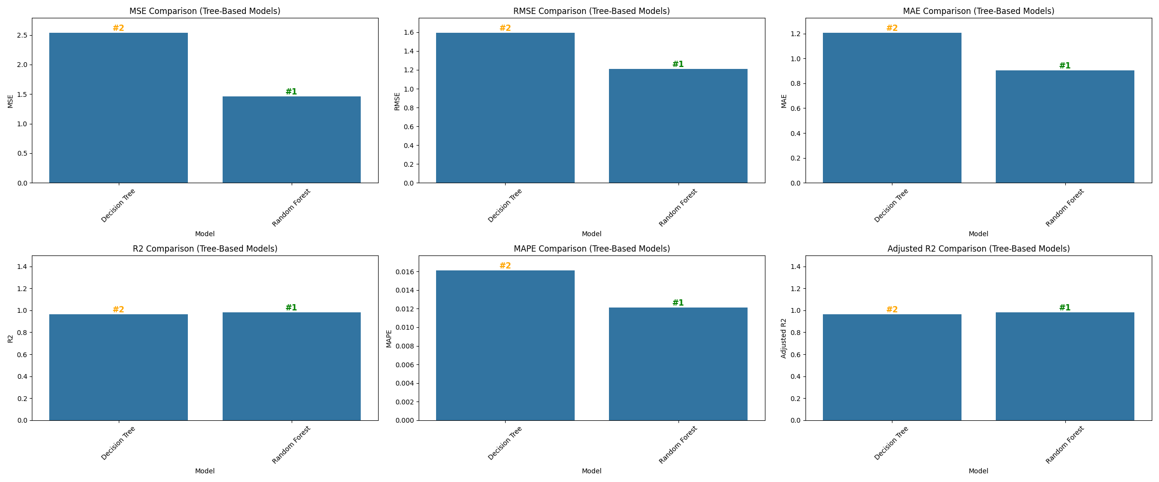
Tree based models – Metrics Comparison
Metric Comparison of Tree Based Model.

Slide 29
Model Selection : Boosting Models
Gradient Boosting Regressor: Sequentially builds models by focusing on the errors of the previous ones, enhancing performance.
AdaBoost Regressor: Adjusts the weights of incorrectly predicted instances to improve model accuracy.
XGBoost: An optimized version of Gradient Boosting that is efficient and widely used in competitive machine learning.
LightGBM: A fast, efficient boosting model that works well with large datasets by using a leaf-wise tree growth algorithm.

Slide 30
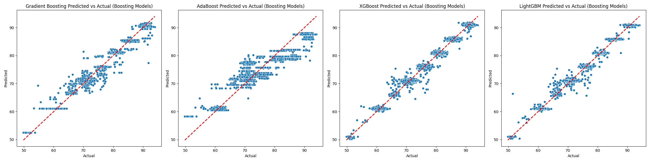
Boosting models– Actual vs Predicted
Scatter Plot Graph of Boosting Model.

Slide 31
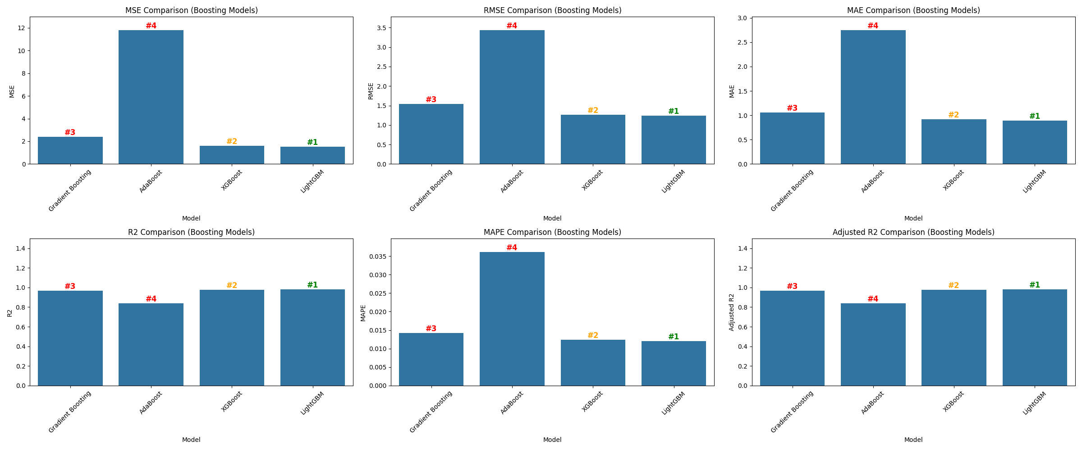
Boosting models – Metrics Comparison
Scatter Plot Graph of Boosting Models.

Slide 32
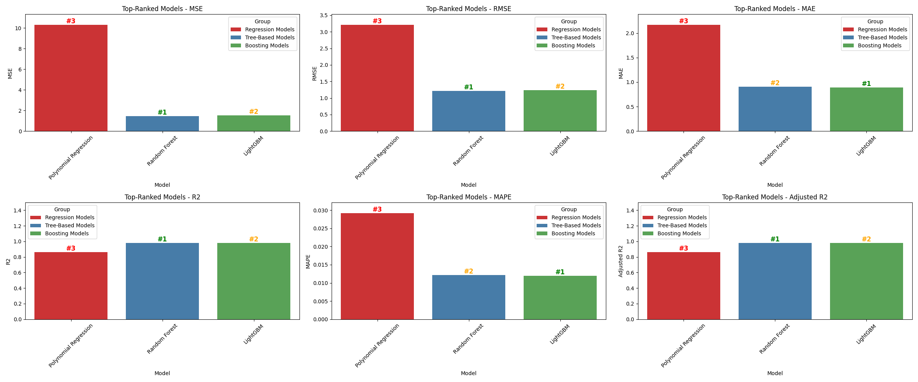
Consolidated model comparison
Consolidated metric Comparison of the Best model from Regression-based, Tree-based, and Boosting Models.

Slide 33
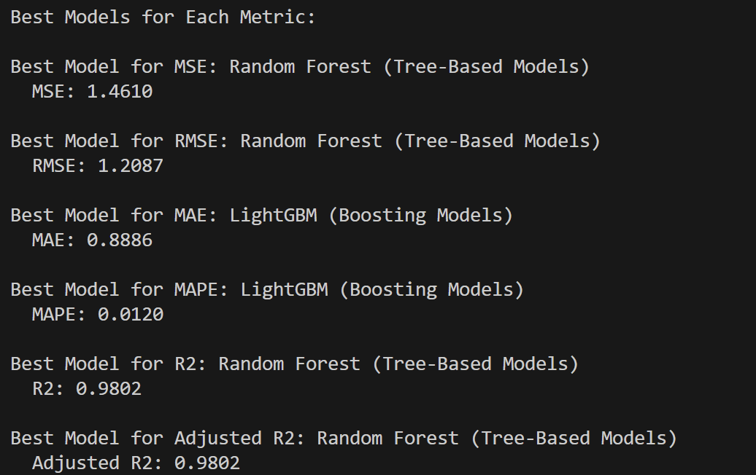
Consolidated model comparison
Best models for various metrics across Regression-based, Tree-based, and Boosting models.

Slide 34
Model Selection - HGBRT
HISTOGRAM-BASED GRADIENT BOOSTING REGRESSION TREE (H-GBRT)
Histogram-based Gradient Boosting Regression Trees (HGBRT) is a machine learning algorithm that builds multiple decision trees using a technique called boosting. It partitions continuous features into discrete bins (histograms) to speed up training and improve efficiency. HGBRT is particularly effective for large datasets due to its scalability and robust performance.
For parameter optimization
Grid Search: Exhaustively searches through a predefined set of hyperparameters.
Random Search: Randomly samples hyperparameters within specified ranges.
Bayesian Optimization: Uses probabilistic models to predict the performance of hyperparameters and efficiently search the space.

Slide 35
Requirements
Hardware Requirements:
Processor: Intel i5 series
RAM: 8 GB
GPU: 4 GB
Software Requirements:
Operating System: Windows 10,11, MacOS
Coding Language: Python
Packages: Keras, Torch, Matplotlib, Tensorflow, Random, Pandas, Scikit-learn, NumPy
IDE: Google Colaboratory, Visual Studio Code

Slide 36
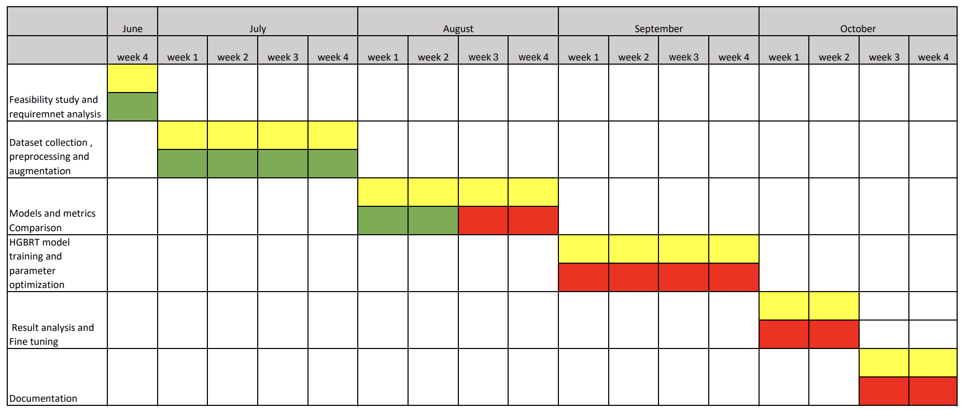
Timeline chart: -
Work done
Works Assigned
Works to be done

Slide 37
References: -
Gao Z. 5G Traffic Prediction Based on Deep Learning. Comput Intell Neurosci. 2022 Jun 24;2022:3174530. doi: 10.1155/2022/3174530. PMID: 35785055; PMCID: PMC9249458.
Zamzami, Ikhlas. (2022). Deep Learning Models Applied to Prediction of 5G Technology Adoption. Applied Sciences. 13. 119. 10.3390/app13010119.
L. Li and T. Ye, "Research on throughput prediction of 5G network based on LSTM," in Intelligent and Converged Networks, vol. 3, no. 2, pp. 217-227, June 2022, doi: 10.23919/ICN.2022.0006Qin, Z., Weng, J., Cui, Y., & Ren, K. Privacy-preserving image processing in the cloud. IEEE Cloud Computing (2018).
G. Nencioni, R. G. Garroppo and R. F. Olimid, "5G Multi-Access Edge Computing: A Survey on Security, Dependability, and Performance," in IEEE Access, vol. 11, pp. 63496-63533, 2023, doi: 10.1109/ACCESS.2023.3288334.
L. Zhang, W. Yang, B. Hao, Z. Yang and Q. Zhao, "Edge Computing Resource Allocation Method for Mining 5G Communication System," in IEEE Access, vol. 11, pp. 49730-49737, 2023, doi: 10.1109/ACCESS.2023.3244242.
Rekoputra, Nadhif Muhammad, Chia-Wei Tseng, Jui-Tang Wang, Shu-Hao Liang, Ray-Guang Cheng, Yueh-Feng Li, and Wen-Hao Yang. 2023. "Implementation and Evaluation of 5G MEC-Enabled Smart Factory" Electronics 12, no. 6: 1310

Slide 38
References: -
Xavier, Ruben, Rogério S. Silva, Maria Ribeiro, Waldir Moreira, Leandro Freitas, and Antonio Oliveira-Jr. 2024. "Integrating Multi-Access Edge Computing (MEC) into Open 5G Core" Telecom 5, no. 2: 433-450.
G. Chen, R. Huang, X. Tang and Q. Huang, "Research on the 5G MEC Co-construction and Sharing," 2024 4th International Conference on Neural Networks, Information and Communication Engineering (NNICE), Guangzhou, China, 2024, pp. 1187-1191, doi: 10.1109/NNICE61279.2024.10499087.

Slide 39
THANK YOU!

